Slide 1


Sprint delivery
Sprint 3
Wednesday 29 June 2022

Slide 2
Content
Sprint 3
Semester conclusion
General administration
Performance definition
Huawei database extraction
Transfer document
Dashboard

Slide 3
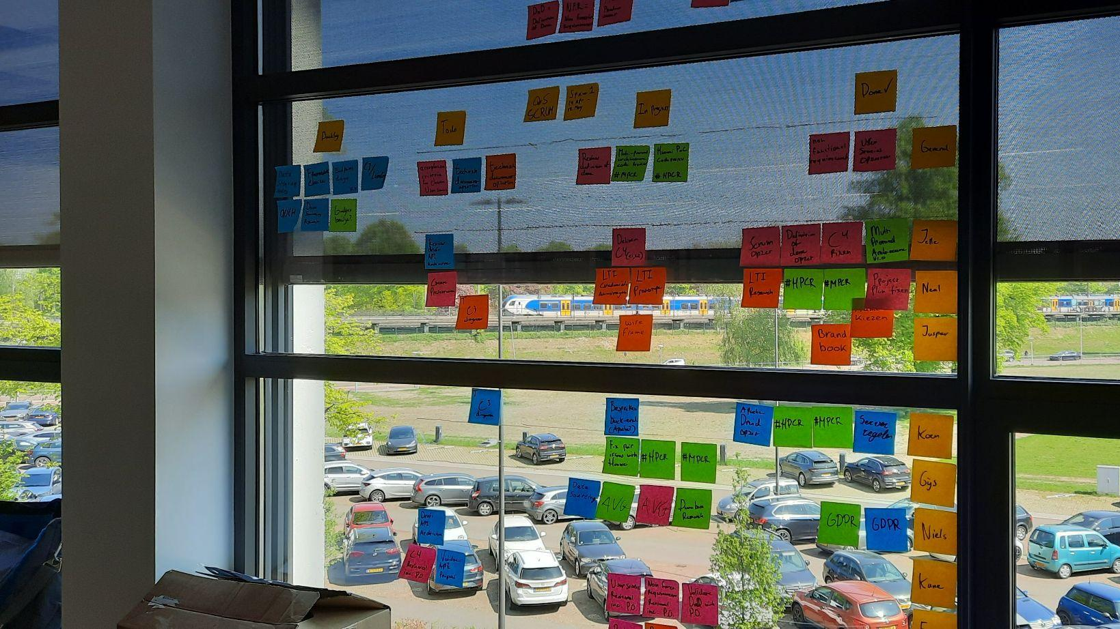
Sprint 3
“The handover”
Notes:
The main mission for the first sprint

Slide 4
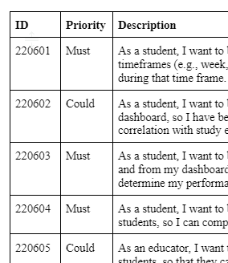
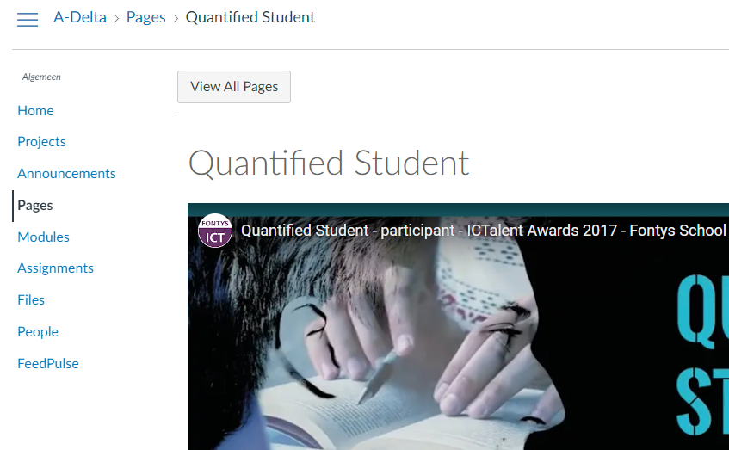
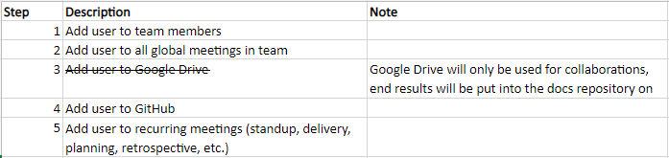
General administration
Delta main course update
User story priority
Process for new developers

Slide 5
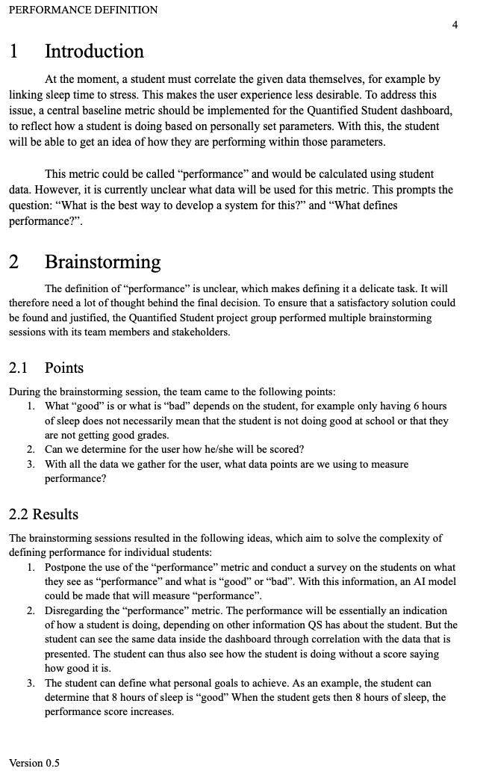
Performance definition
Outlined outcome brainstorming session
Proposed approach
Next steps
Conclusion

Slide 6
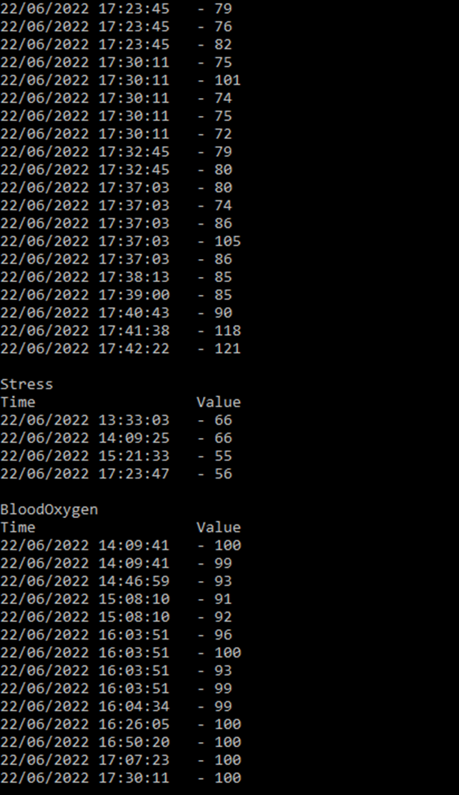
Huawei database extraction
The app saves encrypted database files of the biometric data.
With a rooted phone, it is possible to extract and decrypt the data.
Demo

Slide 7

Transfer document
Index of the project
Short description of each subproject
Where files are located

Slide 8
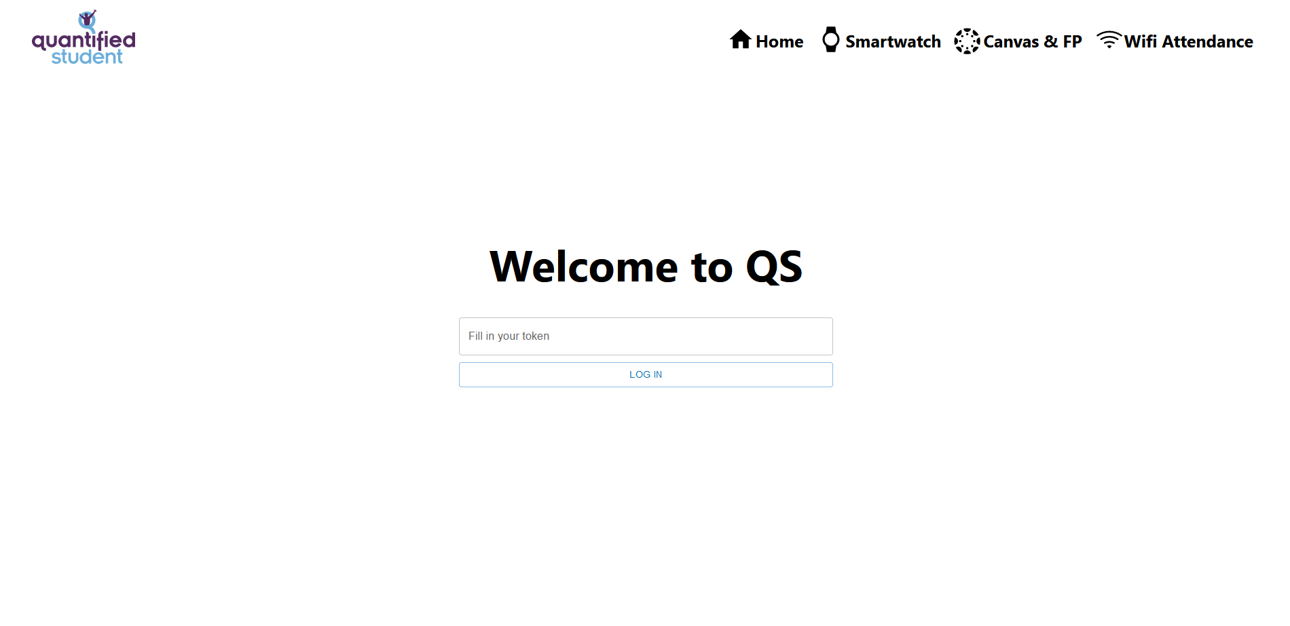
Dashboard
Notes:
I have added a Login for the dashboard for the students to fill in their token.

Slide 9
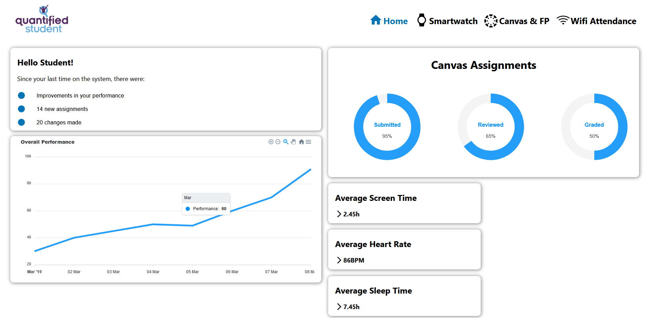
Dashboard
Notes:
I’ve added a home where all general data is shown (this is still mock).

Slide 10
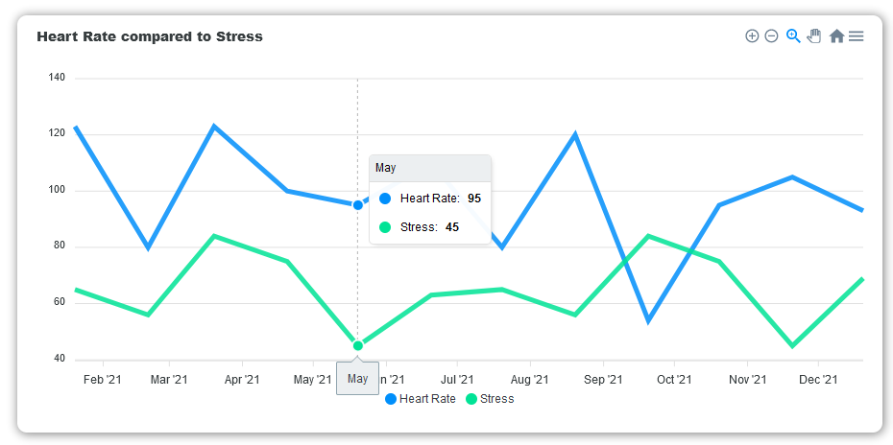
Dashboard
Notes:
We also successfully made a link between the API and the dashboard. The dashboard now shows data from the API within this graph.

Slide 11
Technical Document
API Model
{
"identifier": "unique_identifier",
"options": {
"stress": {
"axis": "x",
"format": "int"
},
"time": {
"axis": "y",
"format": "datetime"
}
},
"data": [
{ "stress": 100, "time": "1656405884519" }
]
}

Slide 12
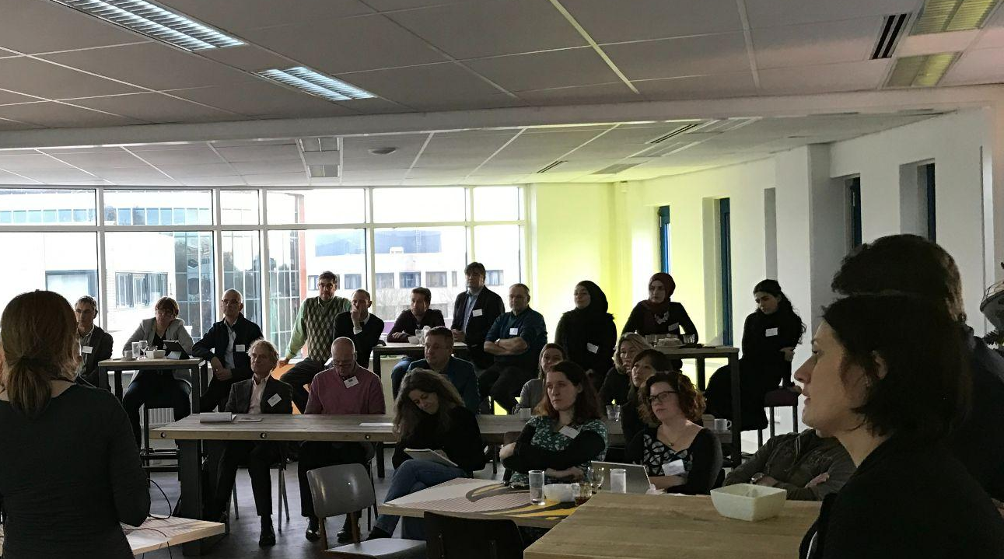
Semester conclusion
“Quantified student defined and prototyped”

Slide 13
Definitions
Prototypes
General project plan
Technical documentation main API
LTI prototype reflection
Performance definition
Brand book
Smartwatch data extraction
API and dashboard communication

Slide 14
End of sprint delivery
Any questions?
Wednesday 29 June, 2022

